Slide 1

Team: JABA Project: Judas Case Management System
Presenter: Angela Reaves

Slide 2
Team Members
Jennifer Starling – Project Manager
Angela Reaves – System Architect
Bonnie Ellis – Database Designer
Amir Yousef – Quality Assurance Manager

Slide 3
Project Description
Judas is a Civil Court Case Management System accessed through a secure PHP/MySQL web application.
Judas allows for civil court cases to be efficiently processed by maintaining a court schedule and tracking legal documents through a docketing process.
Judas has role-specific functionality for judges, attorneys and clerks of the court.

Slide 4
This Week’s Accomplishments
We discovered that we couldn't launch the site with a Java/Tomcat/JSP environment with FSU servers and opted to change to a PHP/Apache environment.
Set up new IDE Netbeans, AMP (Apache MySQL, PHP) environment.
Started implementation of the Login screens and administrative classes in PHP.

Slide 5
Next Week’s work
We plan to complete the PHP login classes.
Revise the HTML login screens.
Begin design of HTML layout for user screens.
Begin Functional classes to implement the specific user screens.
Begin Clerk home page implementation.
Finish preliminary database design.

Slide 6
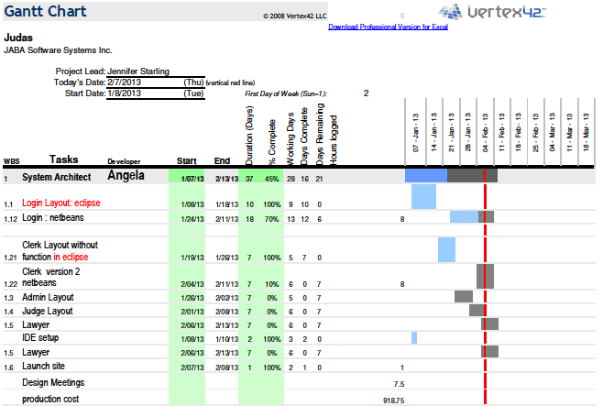
Project Schedule

Slide 7
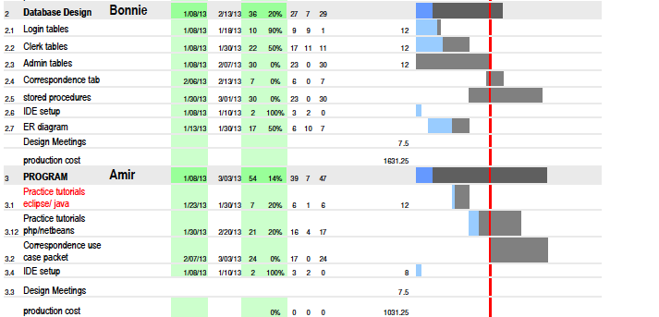
Project Schedule

Slide 8
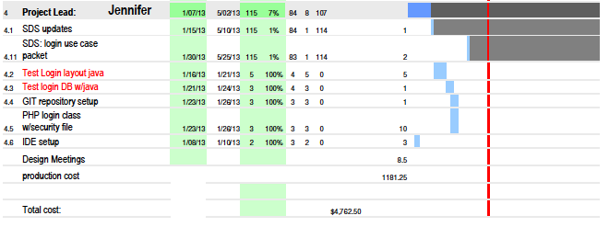
Project Schedule

Slide 9
Expended costs to date
See the Gantt Chart in previous slides for a breakdown of estimated hours and cost per team member.
Total cost to date = $4,762.50

Slide 10
Issues not resolved
Need exact configuration of MySQL URL to connect to MySQL database on FSU servers. FSU instructions to access MySQL database do not indicate how to securely connect to dbsrv2 database server through PHP. Will need to submit a work request to FSU System Administrators.

